Slide 1




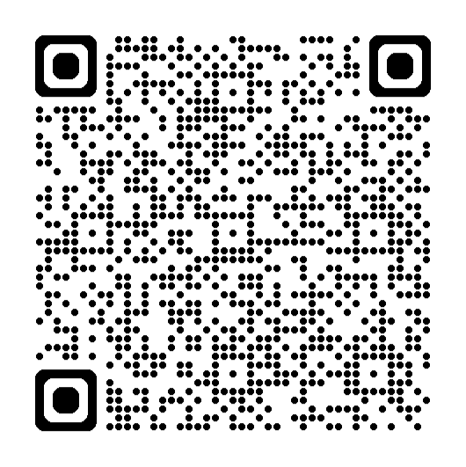
Information for parents and carers
Resilience workshop for parents
With the Mental Health Support Team (MHST)
This parent workshop is designed to help you:
Understand what resilience is and why it is important for children and young people
Learn about the key factors that help children develop resilience
Explore practical ways parents and carers can support and strengthen resilience at home
Understand when and how to seek further support if your child is struggling
Microsoft Teams
Monday 9th February 4:30pm – 5:30pm
Sign up here: https://events.teams.microsoft.com/event/67e24187-fefd-4baf-9e76-234f8cdd023f@b5a4676b-e1c4-4c08-80a9-cf34a2d67324
cypf.berkshirehealthcare.nhs.uk/mhst

